Slide 1
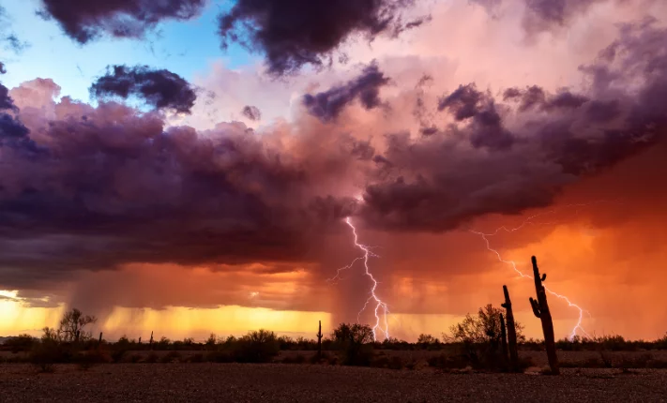
ClimateWins Weather Predictions
July 29, 2025 • Jordan Novelli
Junior Data Analyst
Notes:
Hello and welcome.
I’m Jordan Novelli and in this presentation we’ll focus on weather predictions using machine learning.

Slide 2
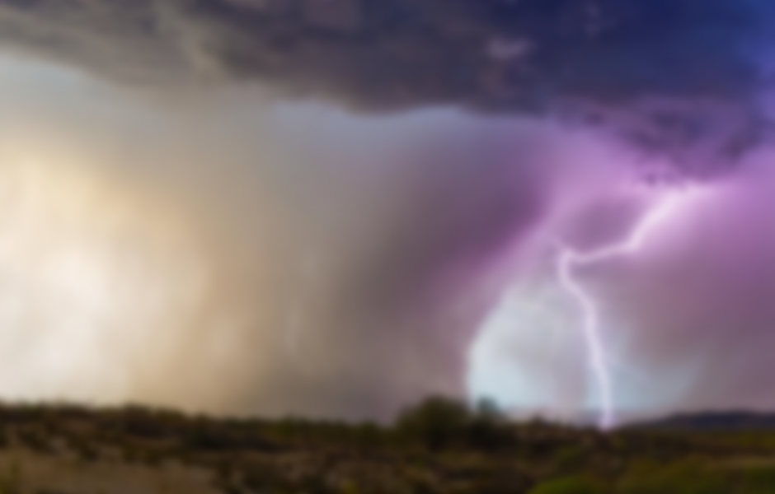
Table of Contents
Objective & Data Sources……………………slide 3
Thought Experiment……………………………slide 4
Algorithms Explored……………………………slide 5-6
Machine Learning Most Applicable……...slide 7-10
Historical Data…………………………………….slide 11
Thought Experiment #1……………………….slide 12
Thought Experiment #2………………………slide 13
Thought Experiment #3………………………slide 14
Summary…………………………………………….slide 15
Analyst Information…………………………….slide 16
Notes:
This is a simple table of contents that contains links and shows you the number of slides associated with each title.

Slide 3
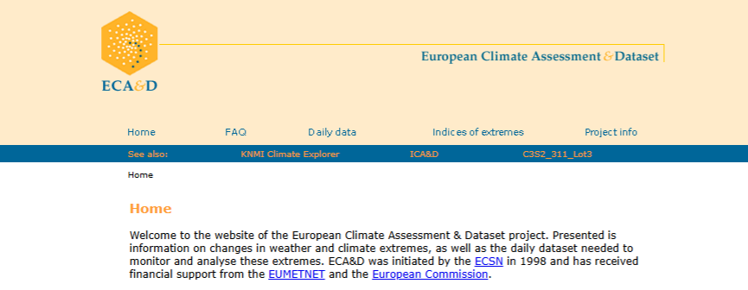
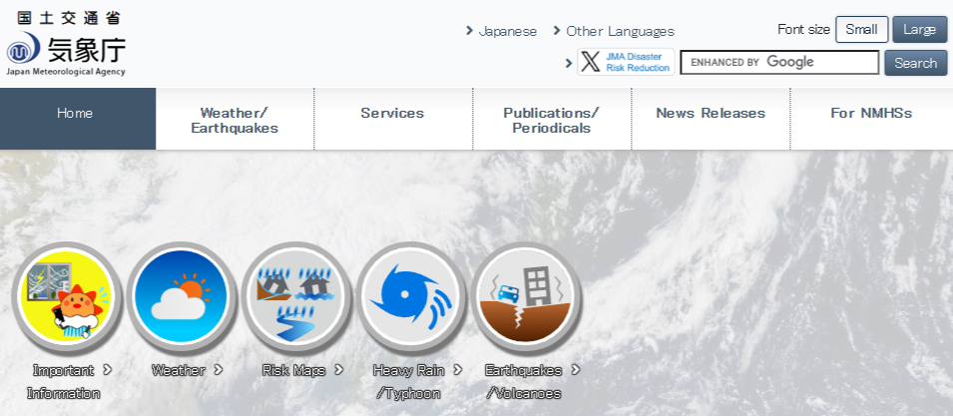
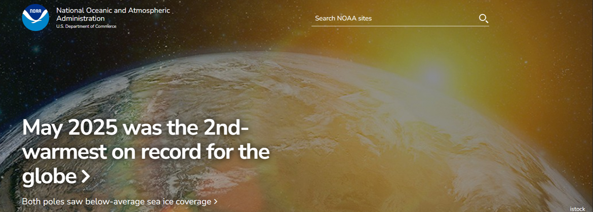

Objective & Data Sources
Objective:
Unveil capabilities of predicting climate change in Europe with Machine Learning.
Working for a non-profit organization, I’m tasked with utilizing my skills as a data analyst, data scientist, researcher and a trainee. I’m trained on the job to learn and employ machine learning to help ClimateWins achieve its goal of understanding weather and its effects in Europe.
Data Source:
European Climate Assessment & Data Set project
The National Oceanic and Atmospheric Administration (NOAA)
The Japan Meteorological Agency (JMA)
Notes:
Objective:
Can machine learning predict climate change in Europe. This project reflect myself as a junior data analyst working as a data scientist, researcher and a trainee to train with machine learning methods and deploy them to accomplish this goal.
Data Sources:
The data used comes from the European Climate Assessment & Dataset. This data is comprised of 18 different weather stations across Europe. The data ranges from 1960-2022. That gives us 62 years of weather information to work with.
Fictional company ClimateWins has been using hurricane predictions from the National Oceanic and Atmospheric Administration as well as the Japan Meteorological Agency’s typhoon data. ClimateWins wants to help predict the consequences of climate change.

Slide 4

Thought Experiments
Can machine learning use historical weather data to predict weather trends for the following year(s)?
Can machine learning predict the amount of rain or snow that will accumulate based on cloud coverage, precipitation, and snow accumulation from prior seasons?
Can machine learning more accurately predict the improvement or decline of global warming?
Notes:
These Thought Experiments helped to generate a better understanding of what I would like to see from Machine Learning.
It also opens the door to explore further into Machine Learning to one day be able to predict such accuracy.
Currently meteorologist can accurately predict the weather about 7-10 in advance. Anything that’s 10 days or more has an accuracy of about 50% leading up to its prediction.

Slide 5
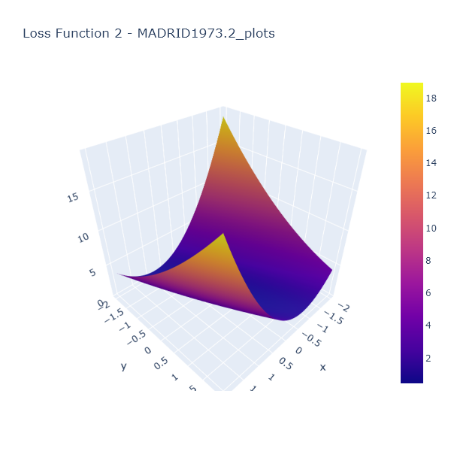
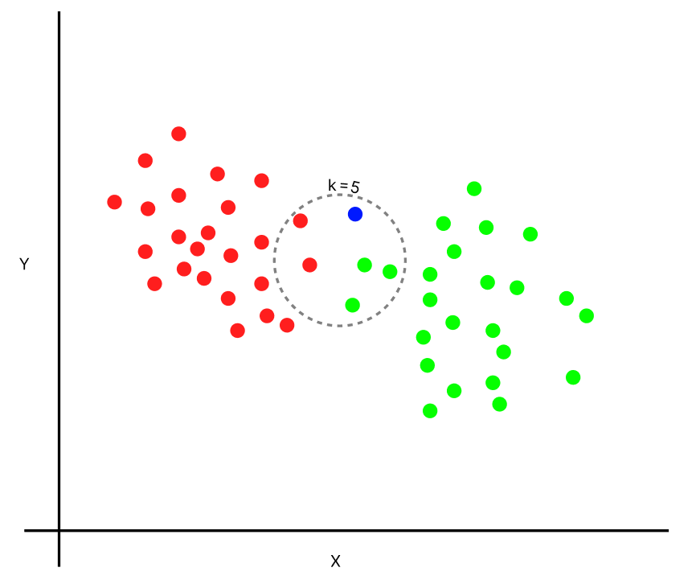
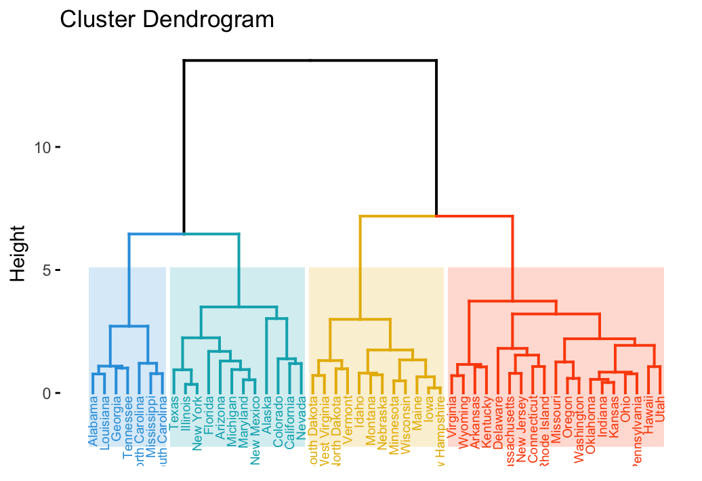
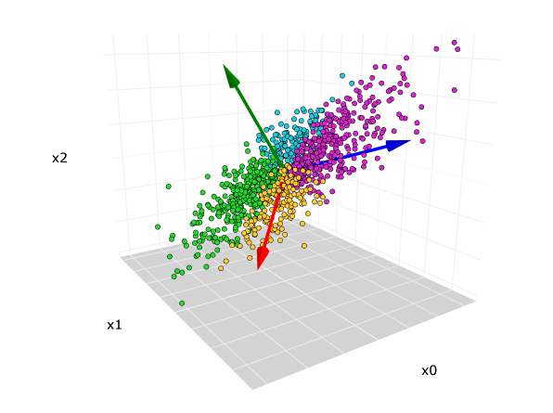
Algorithms Explored
Optimal Algorithms:
Gradient Descent
A simple way tot find a local minimum for linear and nonlinear cases.
Supervised Learning:
K-Nearest Neighbor with Confusion Matrix
An instance-based algorithm used for classification and regression.
Decision Tree
Classification-based algorithm where each decision narrows down a solution.
Artificial Neural Networks (ANN)
Supervised learning that acts as unsupervised learning, this algorithm takes data and uses hidden layers to determine the output. This algorithm can determine patterns, classify data and predict outcomes.
Unsupervised Learning:
Dendrograms
A type of agglomerative clustering used to visualize hierarchical relationships with data points or clusters.
Principal Component Analysis (PCA)
Finds linear representation in data sets by looking at variances and turning the data into linear vectors.
Notes:
Several additional Machine Learning methods were implemented in this tasks.
Optimal Learning:
In the first portion of the project Optimal Algorithms such as Gradient Descent were used along with scaling the data and sorting it in box-and-whisker plots. The GD provided visualization of how temperatures changed over the course of a year.
Supervised Learning:
K-Nearest Neighbor along with the Confusion Matrix allowed for training and testing to determine the accuracy of the algorithm to sort it into pleasant weather or unpleasant weather.
Decision Trees were more difficult to use with the entire data set, however, when used for a single weather station they were more likely over fitting the data.
Dendrograms were partnered with the Principal Component Analysis to reduce the data and visualize it. Further methods such as scatterplots and swarm plots were used to aid in understanding pleasant and unpleasant weather were sorted.

Slide 6
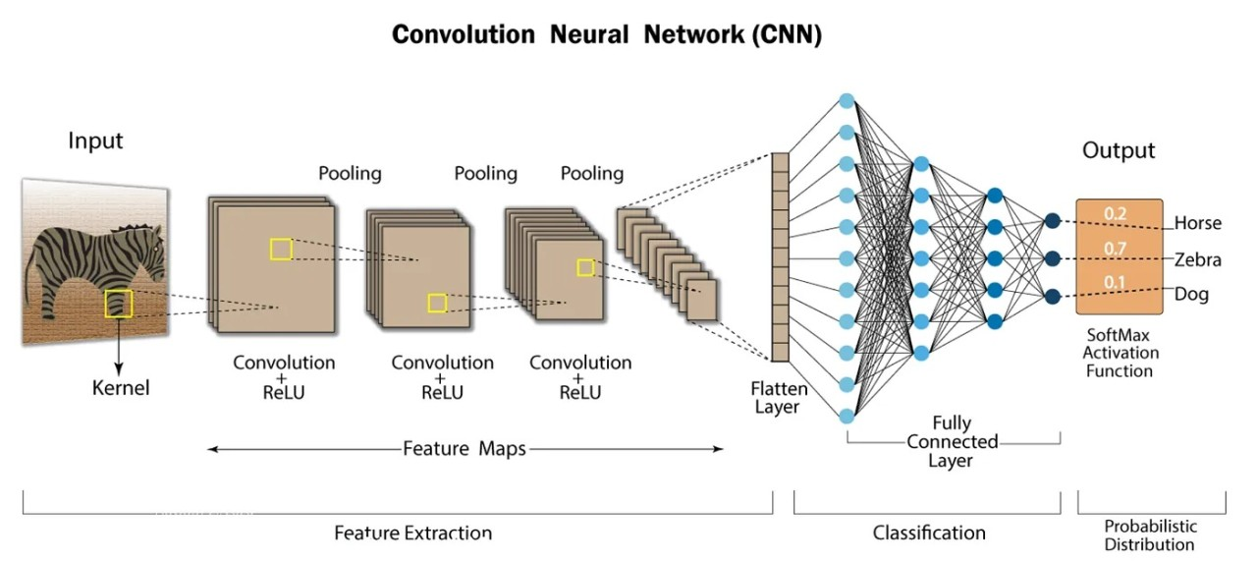
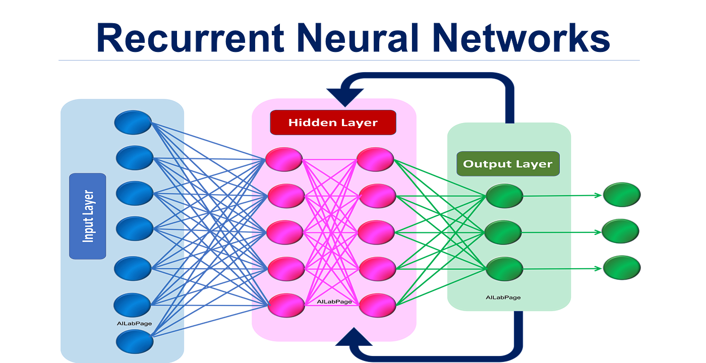
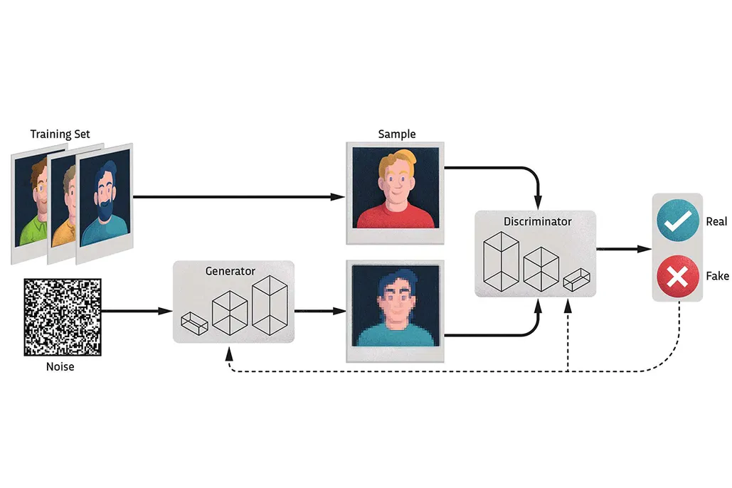
Algorithms Explored
Deep Learning:
Convolution Neural Networks (CNN)
These models work well with images or numerical data, having hidden layers that can assess the data and become more complex as they communicate.
Recurrent Neural Networks (RNN) with Long Short-Term Memory (LSTM)
A model that works well with text and speech it also contains a type of internal memory to feed its flow from input, hidden layer and output. LSTM are improved RNN that forgets unimportant data before continuing to process further.
Random Forest
A collection of decision trees, this model trains many models simultaneously to solve a singular problem.
Hyperparameters and Tuning models
Hyperparameters are the control of the overall machine learning models. Tuning models such as grid search, random search and Bayesian optimization allow for fine tuning of algorithms such as RNN and Random Forests.
Generative Adversarial Network (GAN)
Using generators and discriminators, this visual machine learning algorithm tried to determine real from artificial data.
Notes:
Additionally, deep learning methods were used to explore weather classification.
Deep Learning:
Convolution and Recurrent Neural Networks were explored. Convolution Neural Networks are not showcased in this project; however Recurrent Neural Networks were used. Using the Recurrent Neural Network method I was able to adjust the various aspects and create accuracy ranging from 81%-96%.
Random Forest was used to determine the importance of the various weather station observations. I was able to extract the weather stations that had the most influence on the RF and determine the factors that were most important from those weather stations.
The Hyperparameter and Tuning Models were interesting to explore, but when implementing them they didn’t provide better results than the original algorithms themselves.
Exploring the Generative Adversarial Network was extremely interesting and after using it I found it valuable. I would consider running CNN and GAN with this data to help these algorithms determine pleasant weather with images.

Slide 7
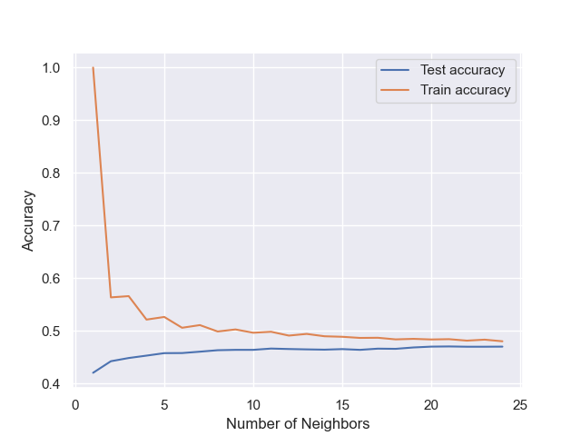
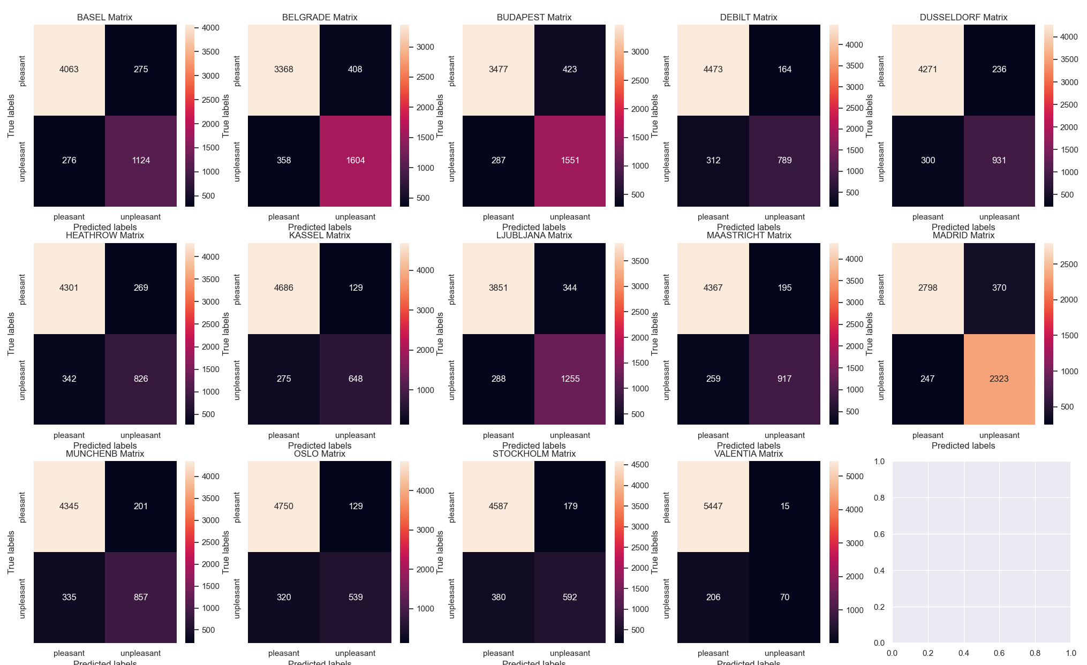
Machine Learning Most Applicable
ClimateWins’ goal is to predict the consequences of climate change in Europe.
Options most likely to achieve this goal:
K-Nearest Neighbor (KNN)
Artificial Neural Networks (ANN)
Convolution Neural Networks (CNN)
Generative Adversarial Networks (GAN)
K- Nearest Neighbor with Confusion Matrix
Adjusting the number of neighbors
Pairing KNN with Confusion Matrices allow for better understanding of how pleasant and unpleasant weather is grouped.
Notes:
With ClimateWins goal being able to predict consequences of weather in Europe there are a few ML methods I think are more applicable for their goals.
K-Nearest Neighbor
Artificial Neural Networks (ANN)
Convolution Neural Networks (CNN)
Generative Adversarial Networks (GAN).
K-Nearest Neighbor
Using KNN in this project I could easily see where the training and testing accuracy started and ended up. Adjusting the number of neighbors, I was able to improve the accuracy.
When using 25 nearest neighbors I could see that the training accuracy started at 100% then dropped to about 56%. The testing accuracy started at about 42% and increased to about 47%.
The confusion matrices created from the KNN using 25 neighbors was more accurate than my KNN that used 5 neighbors and 15 neighbors. The Confusion Matrix was able to show me an average of 72% indicating pleasant weather and 16% indicating unpleasant weather with just 8% grouped as unknown.
This algorithm creates a great visual and understanding of how the weather data and the predictive data work with each other. With more tweaking this algorithm may be able to reach higher training and testing rates and be better able to group pleasant and unpleasant weather in Europe.

Slide 8
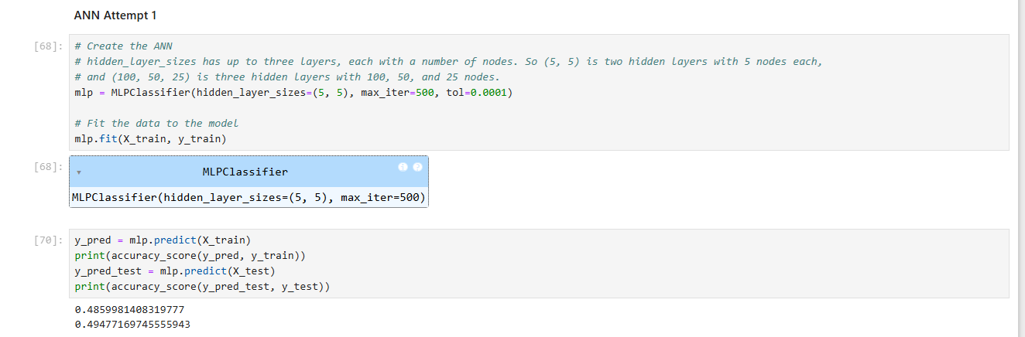
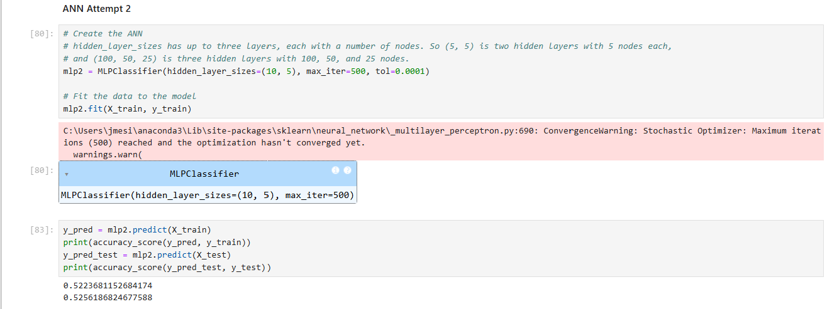
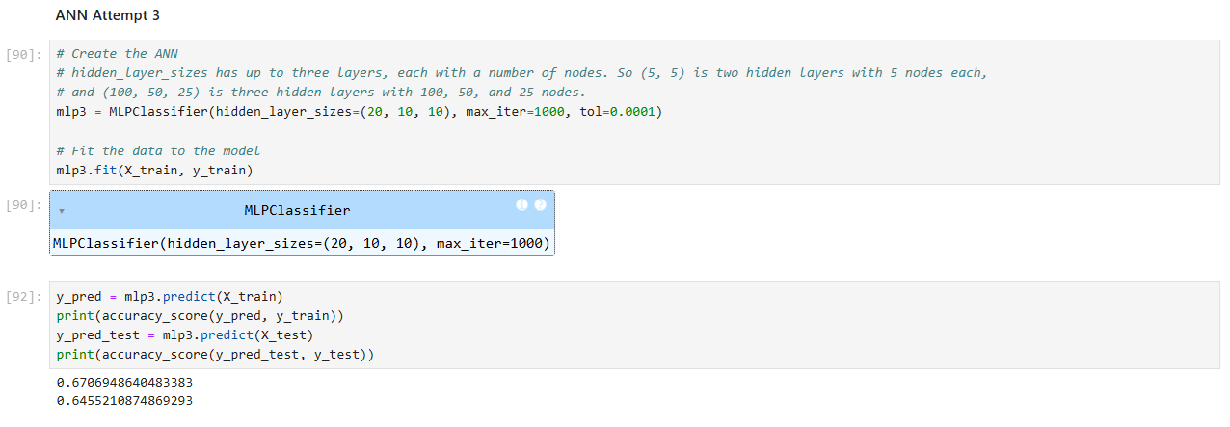



Machine Learning Most Applicable
Artificial Neural Networks
Adjust Hidden Layer Size
Adjust Iterations
Adjust Loss
Notes:
Artificial Neural Networks (ANN)
Using Artificial Neural Networks in my previous machine learning scripts, I was able to produce training rates up to 67% accuracy and testing rates up to 64% accurate.
This was due to the ability to adjust the hidden layer size, iterations and the loss.
While these rates aren’t perfect, they started as low as 48% and increased significantly with those adjustments.
With additional adjustments I believe this algorithm has the potential to produce higher accuracy.

Slide 9
Machine Learning Most Applicable
Convolution Neural Networks
This algorithms works well with images and numerical values.
This algorithm paired with GAN or even amplified with hyperparameters could promise better predictability of unpleasant weather through imagery or text.
Notes:
Convolution Neural Networks (CNN)
I did not use CNN among my data exploration, I instead used RNN.
However, after using Generative Adversarial Networks, I believe CNN would have been a better choice to explore the data.
There is a potential to manipulate the numerical data in the favor of the CNN to help it to understand how to predict unpleasant weather represented as a 0 and predict pleasant weather represented as a 1.

Slide 10
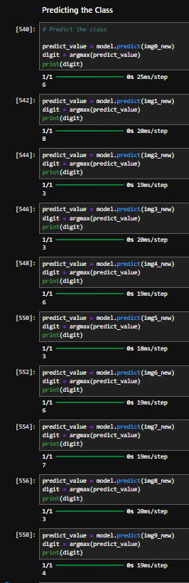
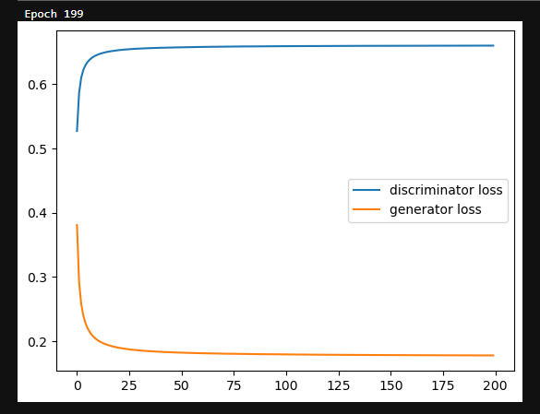
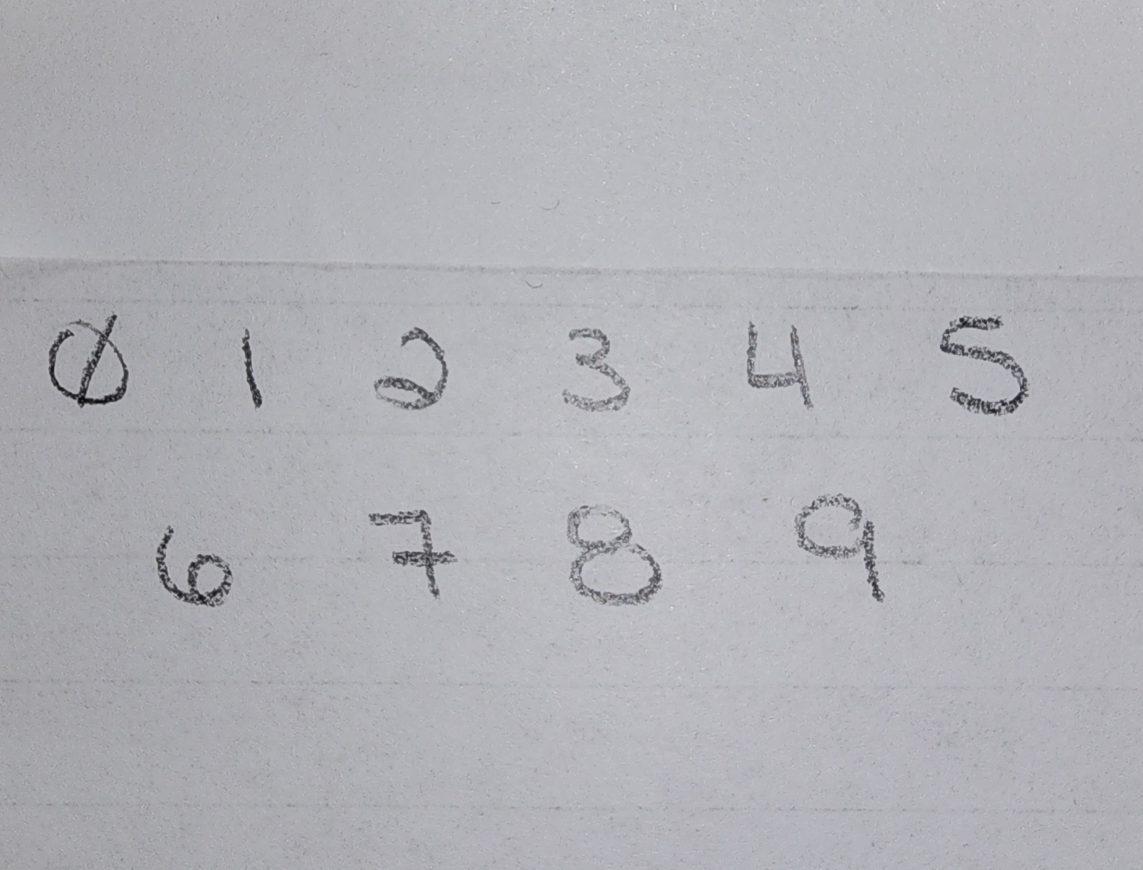
Machine Learning Most Applicable
Generative Adversarial Networks
Generators create data based on real inputs
Discriminator get samples of real and artificial data and try to determine which is which.
Notes:
Generative Adversarial Networks (GAN)
Using Generative Adversarial Networks was extremely interesting.
Knowing that these Machine Learning algorithms have the ability to determine what a number or letter truly represents remarkable.
When using the Generative Adversarial Network paired with images of various weather phenomena, whether that be a sunny day, rainy day, cloudy day or fog, this algorithm is constantly trying to determine what is real and fake.
The algorithm does take a large amount of time and processing power. I believe with further exploration this algorithm can begin to determine a day based on its visual representation more accurately.
The black image shows how CNN tried to determine my hand-written numbers to MNIST (Modified National Institute of Standards and Technology database) number data base. It was only 30% accurate but it was interesting to see that it got anything correct knowing my handwriting style wasn’t within the database it referenced from.
The white image is a loss graph generated based on weather images for radar recognition. I ran 200 epochs and it took 3 hours. The losses never converge but that doesn’t mean that they haven’t learned they just have found their optimum. Further adjustments may help the Generative Adversarial Network to better recognize weather images.

Slide 11
Historical Data
Europe’s Environmental Disasters:
Flooding
Cloud cover, humidity, pressure, precipitation
Heat Wave
Sunshine, Global radiation, temperature max
Cold Spells
Cloud cover, temperature min, snow depth
Earthquakes
No current data
Landslides
No current data
Notes:
Historical Data needed to accomplish ClimateWins Goals:
Recall ClimateWins goal is to predict climate change in Europe.
Current data gives you good information for flooding, heat waves and cold spells such as:
Cloud cover, humidity, pressure, precipitation, sunshine, global radiation, temperature maximums, temperature minimums, and snow depth.
Additional information to increase predictions of floods, heatwaves and cold spells
Ice accumulation
Hail accumulation
Snow clouds identified
Earthquakes and Landslides are common in Europe. Additional Information needed:
Seismic wave data
Richter Scale data to calculate magnitude of an earthequakes
Visual and Auditory data of the environment. This likely could be collected by drones or Satellites.
Deformations in earths crust, slope changes, debris runoff and unusual sounds like cracking/groaning.

Slide 12
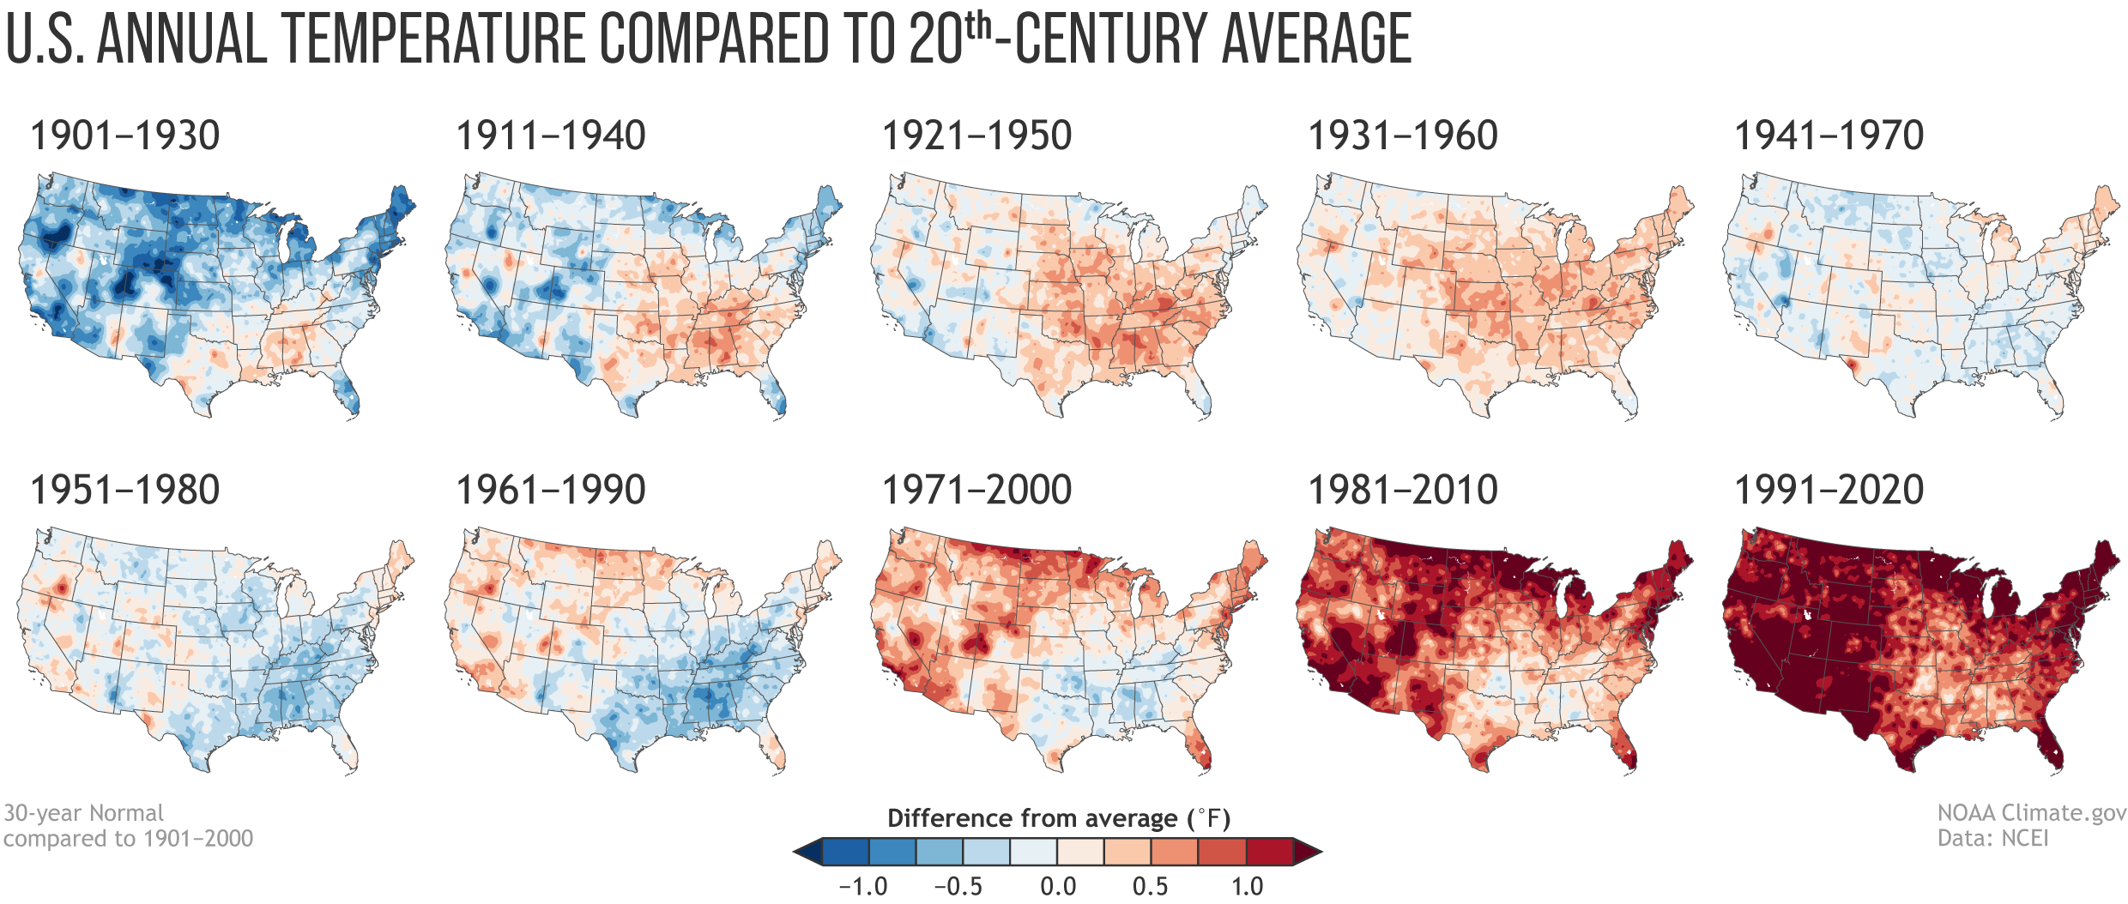
Thought Experiment #1
Can machine learning use historical weather data to predict weather trends for the following year(s)?
Machine Learning Method to Implement:
Artificial Neural Networks (ANN)
Data:
Current data from 1960 - 2022
Notes:
THOUGHT EXPERIMENT #1
Being able to determine heat waves, thunderstorms and heavy snow will lead to more preparedness when dealing with heatstroke cases, flooding evacuations, and vehicular collisions due to snow and ice.
Better strategies to handle these environmental impacts could save lives, reduce costs of lost or damaged buildings, homes or personal property if ample warning time is communicated for evacuation or fortifying buildings.
----------------------------------------------------------------------------------------------------------------------------------
I would suggest using the Artificial Neural Network method using the current data containing information from 1960-2022.
We can begin running predictions on the past data starting in the 1960s and compare it to the real data recorded for the next year that has already be documented.
This allows the algorithms to be trained with data over the last 62 years.
The algorithm can learn where the climate is changing and begin to understand the trends.
It may not be 100% accurate as it can’t account for environmental conservation action that it happening in the real world that may change climate outcome but, its training and testing model would be close.

Slide 13
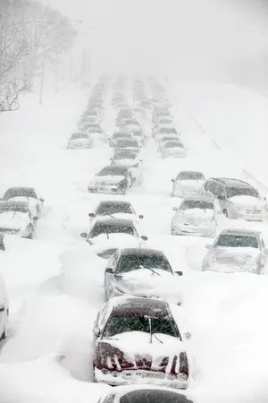
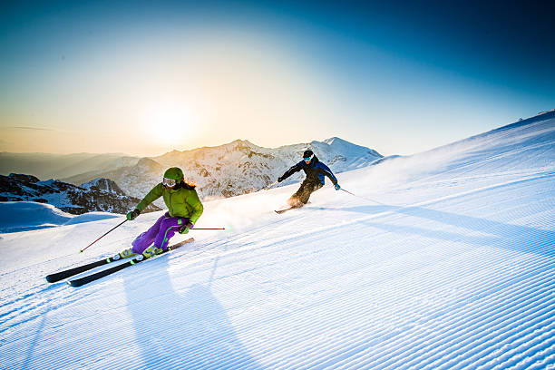
Thought Experiment #2
Can machine learning predict the amount of rain or snow that will accumulate based on cloud coverage, precipitation, and snow accumulation from prior seasons?
Machine Learning Method to Implement:
Convolution Neural Network (CNN)
Data:
Current data from 1960 – 2022
Specifically looking at cloud coverage, precipitation and snow accumulation.
Additionally looking at data containing freezing temperatures, winter storms and longer winters.
Notes:
THOUGHT EXPERIMENT #2
Rain predictions can benefit farmers crops, plant nurseries and help reduce the unnecessary use of sprinklers. Snow predictions can encourage outdoor activities such as snowboarding, skiing and ice skating.
Being able to predict rain ahead of time could influence when farmers plant crops, increasing their production and also benefit plant nurseries to produce more flower and trees more readily. Rain predictions can also prevent crop and plant death if there is a drought expected. Snow predictions can help ski resorts increase their profits with more visitors. The income generated can better assist these resorts in their maintenance of equipment while they prepare for the next winter season.
----------------------------------------------------------------------------------------------------------------------------------
I would suggest using the Convolution Neural Network algorithm with our current data dating from 1960 – 2022.
I would uncover additional data that contains freezing temperature, winter storms and extended winters for better understanding of environmental impacts that lead to these seasonal changes.
Because Convolution Neural Networks can work with images and numerical data. There would be an option to obtain radar images as well as environmental images to pair with the numerical values of these winter changes.
Training this algorithm on the data collected over our 62 years plus any additional years that contain increased winter weather may help to pinpoint what environmental factor contributed to these extremes.
The increased winter weather could then be divided into optimal winter weather ideal for sports or dangerous weather that Europe could plan for.

Slide 14
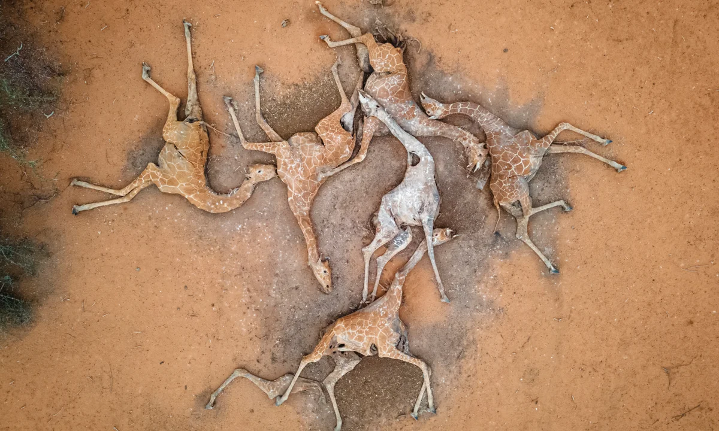
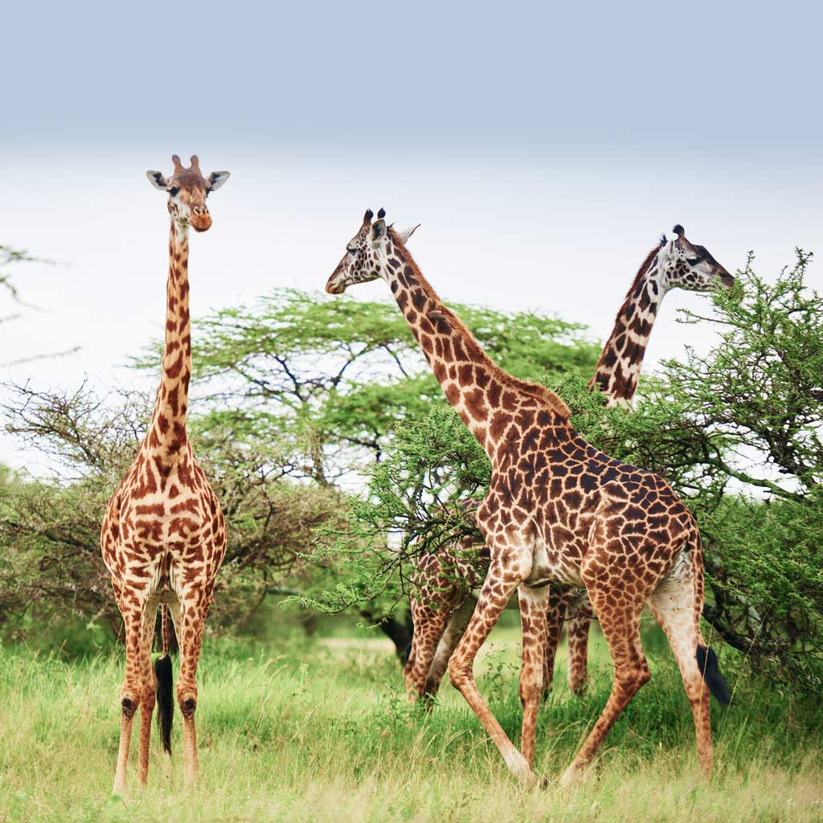
Thought Experiment #3
Can machine learning more accurately predict the improvement or decline of global warming?
Machine Learning Method to Implement:
Gradient Descent
Data:
Global weather data and event data.
Notes:
THOUGHT EXPERIMENT #3
If global warming is improving, we can invest in new ideas to evolve current tactics in place. If global warming is deteriorating, we may be able to create simpler methods to help more people start smaller before they adopt larger improvements.
Once substantial improvements of global warming are witnessed, there may be a domino affect in human interactions that further positive development. We may begin to see less heat waves, more comfortable and enjoyable summers, and colder winters that can be environmentally beneficial.
----------------------------------------------------------------------------------------------------------------------------------
I would suggest using Gradient Descent to predict global warming improvement or decline.
This would be a large project as it would encompass past and current global weather data and environmental events such as wildfires, erosion, droughts, typhoon, earthquakes, melting glaciers and ice caps and many more.
Gradient Descent would be able to use the data well as it’s not linear as things are constantly changing and fluctuating. We can look for global minimums and maximums and determine how global warming is changing.
This could help to predict further environmental disasters or lack there of if there’s improvement.

Slide 15
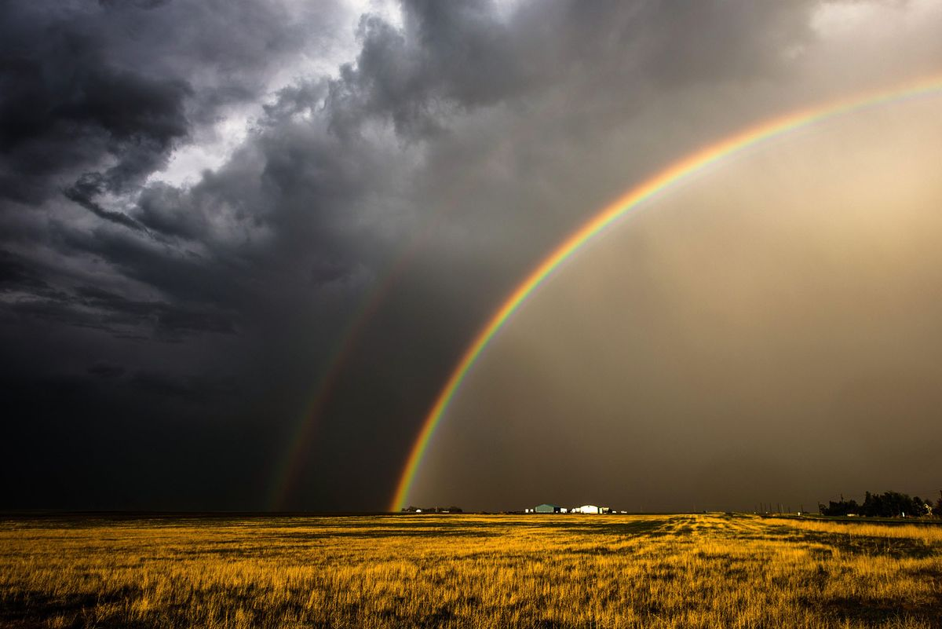
Summary
Thought Experiment #1:
Can machine learning use historical weather data to predict weather trends for the following year(s)?
It’s most likely to align with ClimateWins’ goals.
Most easily executed.
Data is already present.
Next steps.
Notes:
Thought Experiment #1 is most likely to align with ClimateWins goals.
It focuses on weather trends and the current data we have surround Europe’s climate.
The dataset is large with 62 years to analyze but, the outcome would improve predictions.
Benefits:
Increased accuracy for weather predictions for years to come
Better plans for environmental disasters
Better plans for medical relief
Better plans for how to happily enjoy the weather in all seasons if not dangerous

Slide 16




Thank You!
Thank you for joining me on this machine learning journey.
I’m happy to take questions from the audience.
Check out my work for this project on Github.
Check out my LinkedIn
Explore my website outlining my projects.
Jordan Novelli

